Slide 1
E-Ecomerce website
Building with
Laravel 5.6 and Mysql
OU Pisey 20180627

Slide 2
REASON
Project
Clear Concept
Resueablility
Database

Slide 3
Prerequirement
PHP
OOP
HTML
CSS
JS
LARVEL
MYSQL or POSTGRESQL

Slide 4
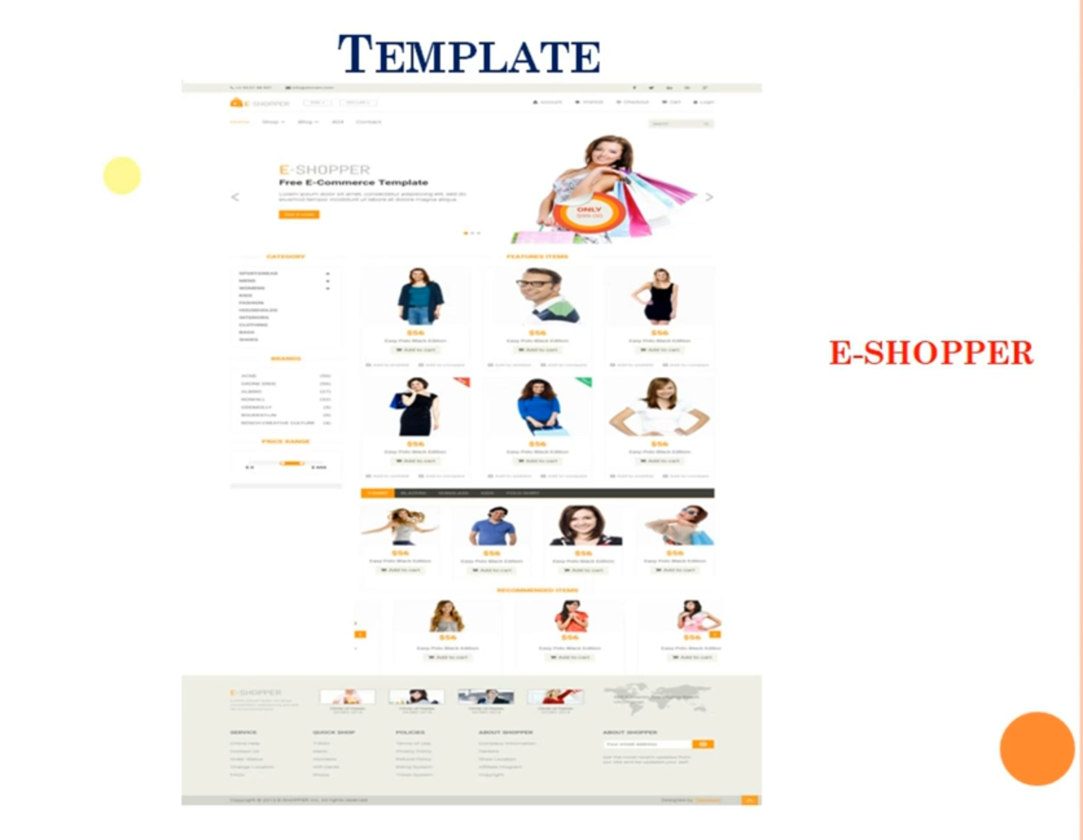

Slide 5
Tool
Xampp/Warmp/Mamp
IDE(sublime,Breackets, visual studeio, atom)
Composer
Favourite food and drink.

Slide 6
Section Admin and User
Admin :
Product add, Project delete, Product descritption.
Category add, and Category delete
Brand add and delete
User :
Just buy product
Add singup and shishlist added

Slide 7
Thanks

